Slide 1

Proofs
Presented by:
Elizer Ponio Jr.
Department of Computer Science
College of Computing and Information Technologies

Slide 2
Outline
Introduction and Definition
Direct Proof
Proof of Contradiction
Proof of Induction
Proof of Contrapositive

Slide 3
Introduction to Proofs
Until this point in your education, mathematics has probably been presented as a primarily computational discipline.
You have learned to:
Solve equations
Compute derivatives and integrals
Multiply matrices and find determinants
And you have seen how these things can answer practical questions about the real world. In this setting your primary goal in using mathematics has been to compute answers.

Slide 4
Introduction to Proofs
But there is another side of mathematics that is more theoretical than computational
Here the primary goal is to:
Understand mathematical structures
Prove mathematical statements
Invent or discover new mathematical theorems and theories

Slide 5
Introduction to Proofs
The mathematical techniques and procedures that you have learned and used up until now are founded on this theoretical side of mathematics.
For example, in computing the area under a curve, you use the fundamental theorem of calculus. It is because this theorem is true that your answer is correct.
However, in learning calculus you were probably far more concerned with how that theorem could be applied than in understanding why it is true. But how do we know it is true?
How can we convince ourselves or others of its validity? Questions of this nature belong to the theoretical realm of mathematics.

Slide 6
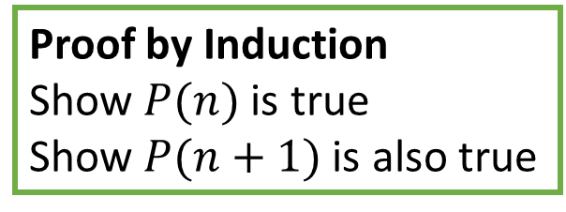
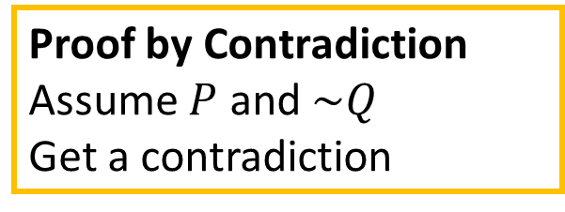

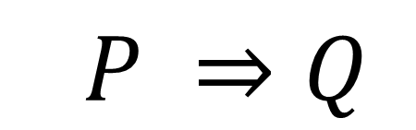
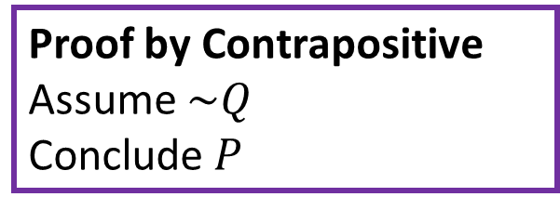
Proof Techniques
$$P ⇒Q$$
Direct Proof
Assume $P$
Conclude $Q$
Proof by Contradiction
Assume $P$ and $\sim Q$
Get a contradiction
Proof by Induction
Show $P(n)$ is true
Show $P(n+1)$ is also true
Proof by Contrapositive
Assume $\sim Q$
Conclude$P$

Slide 7
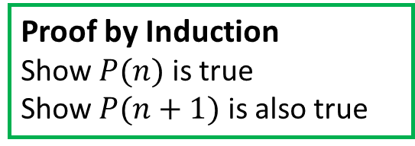
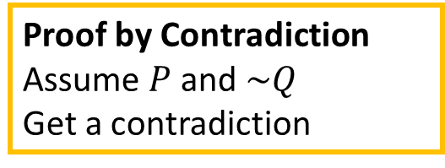
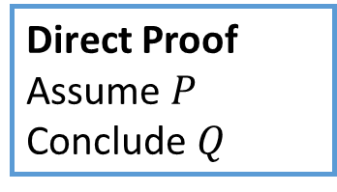
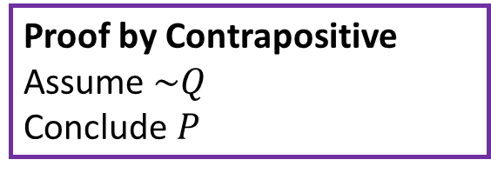
Proof Techniques
We will prove$P ⇒Q$ using the four approaches.
Direct Proof
Assume $P$
Conclude $Q$
Proof by Contradiction
Assume $P$ and $\sim Q$
Get a contradiction
Proof by Induction
Show $P(n)$ is true
Show $P(n+1)$ is also true
Proof by Contrapositive
Assume $\sim Q$
Conclude$P$
In each case, we will prove the following statement:
The sum of any two consecutive numbers is odd.

Slide 8
Definitions
The sum of any two consecutive numbers is odd.
Definition 1
An integer number ‘$n$’ is even if and only if there exists an integer ‘$k$’ such that $n=2k$
Definition 2
An integer number ‘$n$’ is odd if and only if there exists an integer ‘$k$’ such that $n=2k$+1
Definition 3
Two integers ‘$a$’ and ‘$b$’ are consecutive if and only if $b=a+1$

Slide 9
Introduction to Proofs
The sum of any two consecutive numbers is odd.
The statement above may not feel like a $P ⇒Q$ statement, but we can phrase it
If ‘a’ and ‘b’ are consecutive numbers
Then, the sum of ‘a’ and ‘b’ is odd.

Slide 10
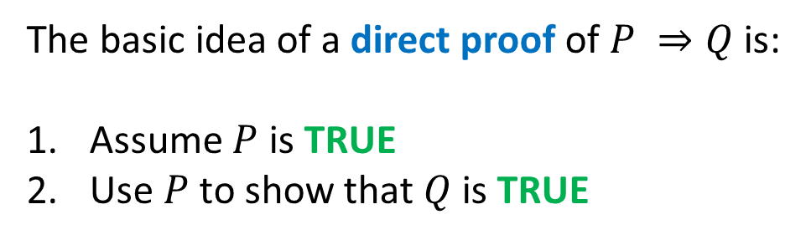
Direct Proofs
The basic idea of a direct proof of $P ⇒Q$ is:
Assume $P$ is TRUE
Use $P$ to show that $Q$ is TRUE

Slide 11
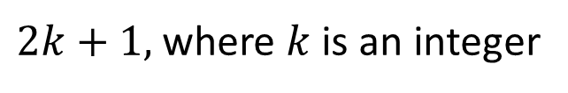
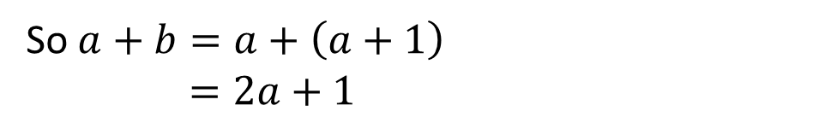
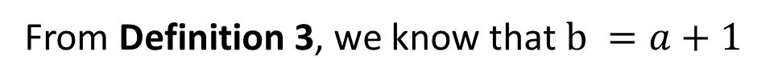


Direct Proofs
If ‘a’ and ‘b’ are consecutive numbers
Then, the sum of ‘a’ and ‘b’ is odd.
Assume $a,b$ are consecutive
From Definition 3, we know that $b =a+1$
So $a+b=a+\left(a+1\right)$
$$=2a+1$$
$2k+1,$where $k$ is an integer
$$∎$$

Slide 12
Proof by Contradiction
The basic idea of proof by contradiction is that a proposition is either TRUE or FALSE, but not both.
We get a contradiction when we can show a statement is both TRUE and FALSE, showing our initial assumptions are inconsistent.
Definition of Contradiction
The fact of something being the complete opposite of something else or very different from something else, so that one of them must be wrong.
“You say that you're good friends and yet you don't trust him. Isn't that a contradiction?”

Slide 13


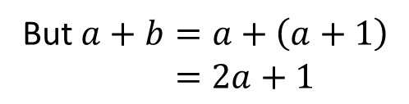




Proof by Contradiction
Assume: If ‘a’ and ‘b’ are consecutive numbers
Assume that $\left(a+b\right)$ is NOT odd
If $\left(a+b\right)$ is NOT odd, then no integer $k$ such that $\left(a+b\right)=2k+1$
But $a+b=a+\left(a+1\right)$
$$=2a+1$$
Shown that $\left(a+b\right)≠2k+1$
Contradict!
But $\left(a+b\right)=2a+1$
By default, $\left(a+b\right)$ is odd
$$∎$$

Slide 14
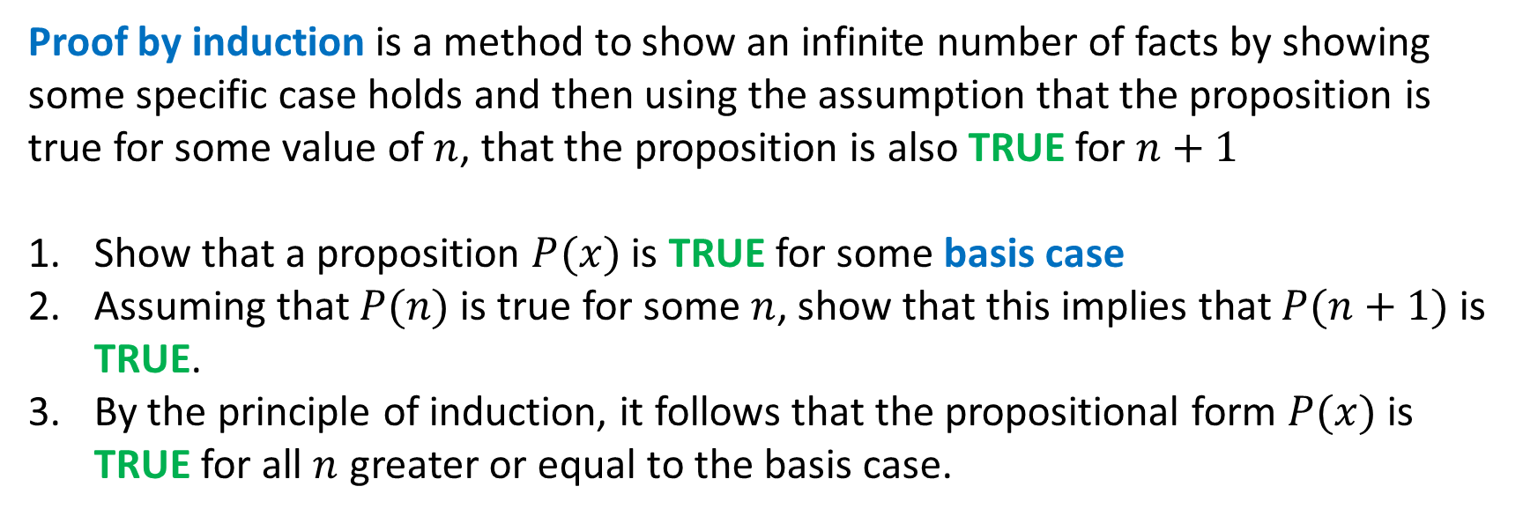
Proof by Induction
Proof by induction is a method to show an infinite number of facts by showing some specific case holds and then using the assumption that the proposition is true for some value of $n$, that the proposition is also TRUE for $n+1$
Show that a proposition $P(x)$is TRUE for some basis case
Assuming that $P(n)$is true for some $n$, show that this implies that $P(n+1)$ is TRUE.
By the principle of induction, it follows that the propositional form $P(x)$ is TRUE for all $n$ greater or equal to the basis case.

Slide 15

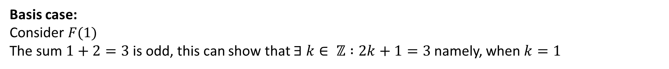

Proof by Induction
Proof: Let the propositional form $F(x)$ be TRUE when the sum of $x$ and its successor is odd.
Basis case:
Consider $F(1)$
The sum $1+2=3$ is odd, this can show that $∃ k∈ ℤ :2k+1=3$namely, when $k=1$
Assume that $F\left(x\right)$ is TRUE for some $x$, Then $x+\left(x+1\right)$ is odd
$$x+1+\left(x+1+1\right)=\left(x+1\right)+\left(x+2\right)=F(x+1)$$
Claim: Since $x+ \left(x+1\right)$ is odd, adding $2$ to this value again gives an odd number.
$$∎$$

Slide 16
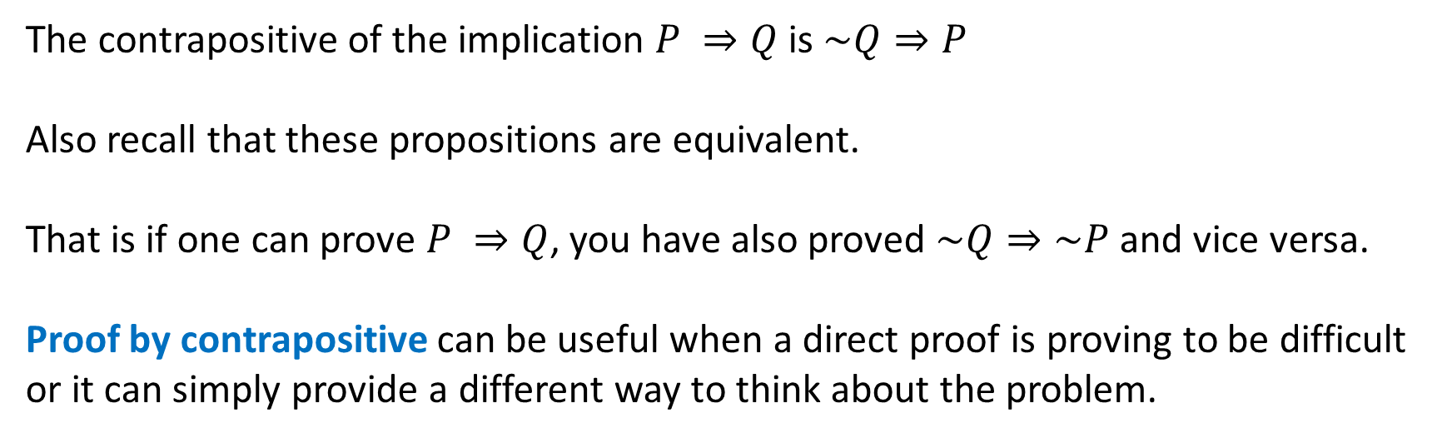
Proof by Contrapositive
The contrapositive of the implication $P ⇒Q$ is $\sim Q⇒P$
Also recall that these propositions are equivalent.
That is if one can prove $P ⇒Q$, you have also proved $\sim Q⇒\sim P$ and vice versa.
Proof by contrapositive can be useful when a direct proof is proving to be difficult or it can simply provide a different way to think about the problem.

Slide 17
Proof by Contrapositive
Definition of Contrapositive
A proposition or theorem formed by contradicting both the hypothesis and conclusion of a given proposition or theorem and interchanging them.
Proposition:
If it rains,
then they cancel school
The contrapositive of the proposition:
If they do not cancel school,
then it does not rain.

Slide 18
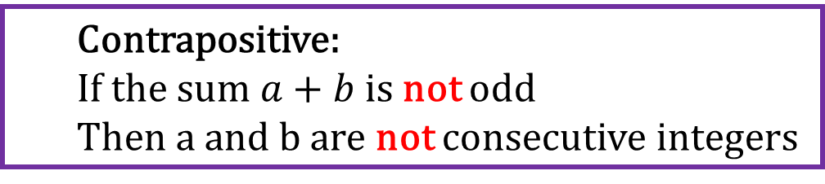
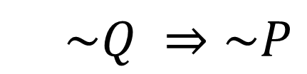

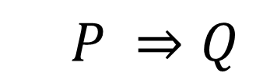


Proof by Contrapositive
$$P ⇒Q$$
If $a$ and $b$ are consecutive integers
Then the sum $a+b$ is odd
Contrapositive:
If the sum $a+b$ is not odd
Then a and b are not consecutive integers
$$\sim Q ⇒\sim P$$
Assume that the sum $a+b$ is not odd. $∄ k∈ ℤ :a+b= 2k+1$
So... $a+b=k+(k+1)$ does not hold for any integer $k$. But $k+1$ is the successor of $k$, this implies that $a$ and $b$ cannot be consecutive.
$$∎$$
Shown:$\sim Q ⇒\sim P$
$$P ⇒Q$$

